Slide 1
Cortica/LEAN.AI Product Engineer Candidate Home Assignment
Prepared by Or Perez

Slide 2
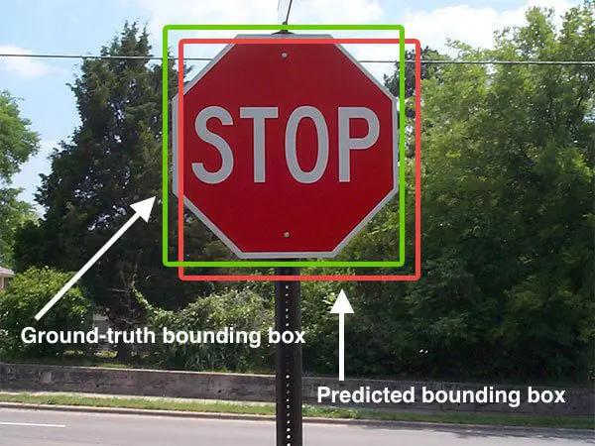
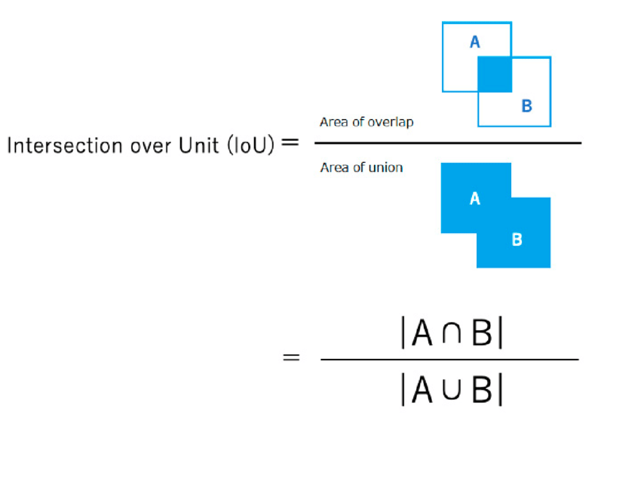
BBox - bounding box: A bounding box is an imaginary rectangle that serves as a point of reference for object detection and creates a collision box for that object.
GT - Ground truth: Ground truth is information that is known to be real or true, provided by direct observation and measurement (i.e. empirical evidence) as opposed to information provided by inference.
Detections - the system bounding boxes outputs.
IoU - Intersection over Union (IoU) - measures similarity between finite sample sets. comes to help us determine the precision or truth of the object detected.
Terminology

Slide 3
Bounding Boxes and positioning precision
But how does object detection work in relation to bounding boxes? Answering this question requires looking at object detection as two components: object classification and object localization. In other words, to detect an object in an image, the computer needs to know what it is and where it is.
In the attached video shown an example the model detection outputs. As we can see, the anotannotator is drawing bounding boxes around objects as vehicles, signs and humas on each frame and label them by Object class (color for each kind of object) together with quantitative info indicates the confidence level of the system. IOU threshold in as it seems in the clip is around 0.8 - higher than this the label box turns green (means it a good match conclude high accuracy).
This helps train an algorithm to understand what vehicles look like. Object detection is a computer vision technique that allows us to identify, locate, and track objects in an image or a video. With this kind of identification, localization, and tracking, object detection can count objects in a scene and determine and track their precise locations while accurately labeling them.

Slide 4
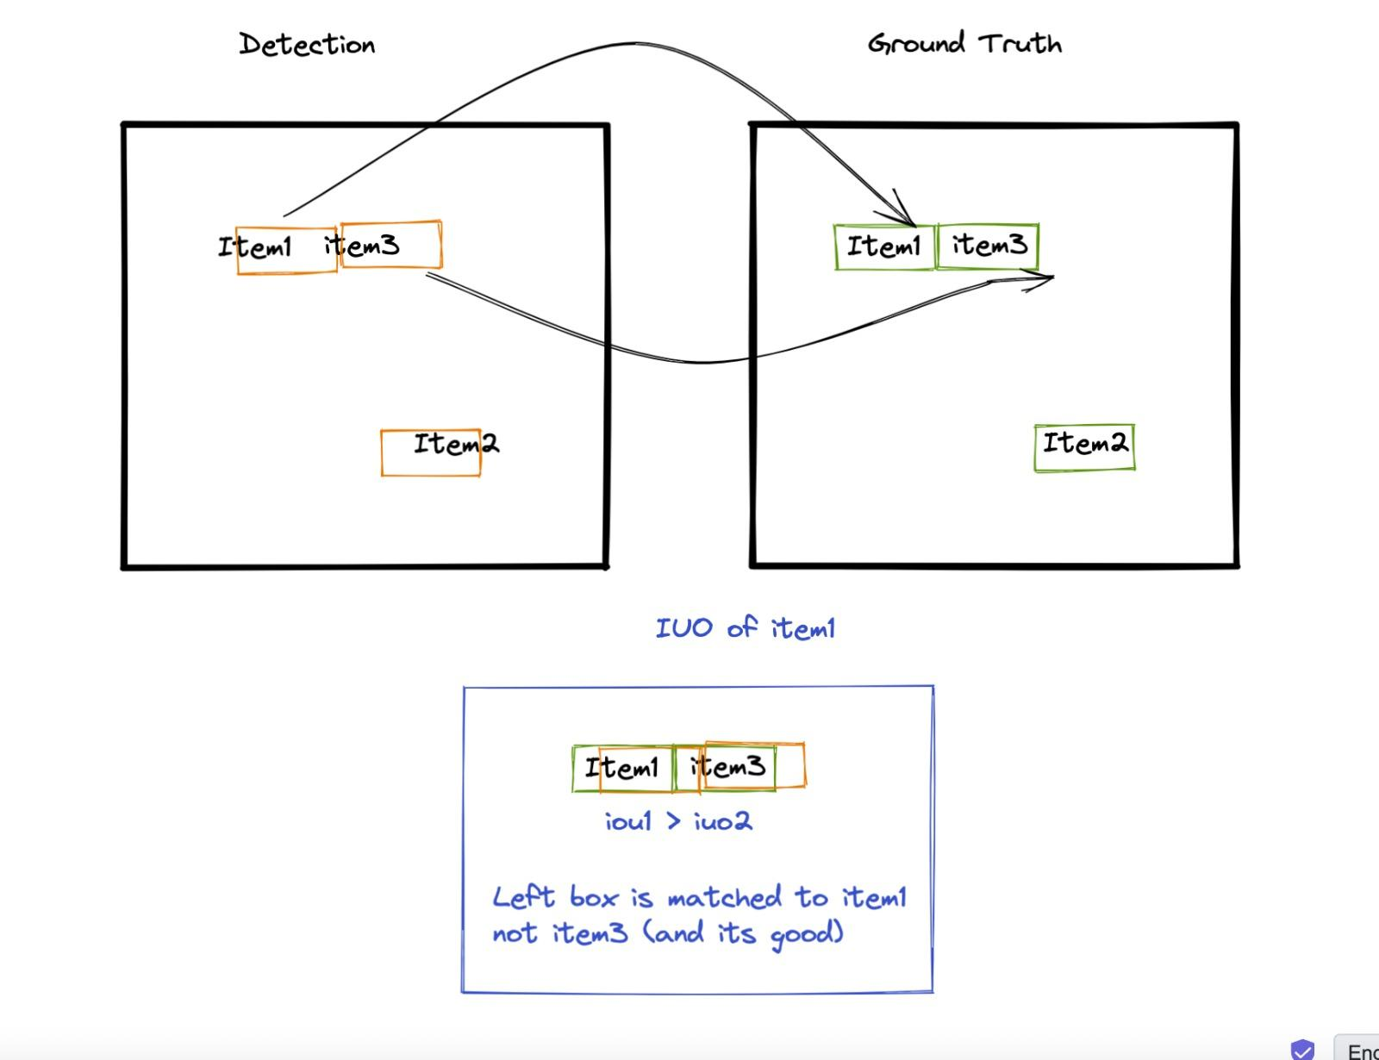
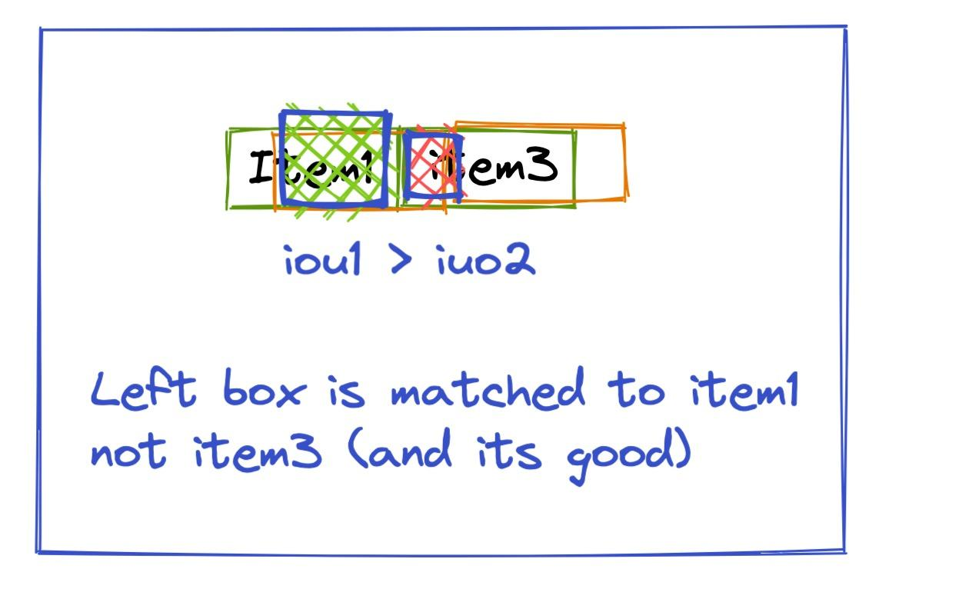
Let take an example:
We can see two relevant points here: 1. IoU for the match of ‘item1’ in both frame is higher than the matching IoU of ‘item3’ in both frames.
2. Detection of ‘item1’ is overlaps with ground truth of ‘item3’ and ‘item1’ - IoU of overlap with ‘item1’ is higher than the one with ‘item3’, hence it’s a better match.

Slide 5
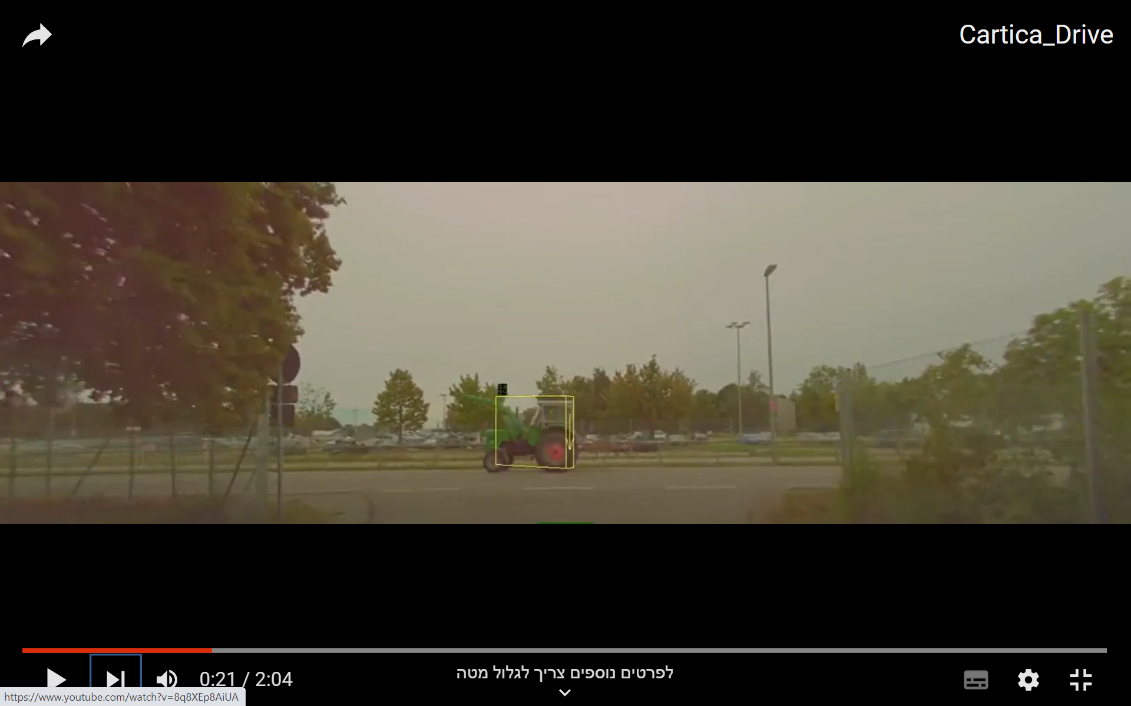
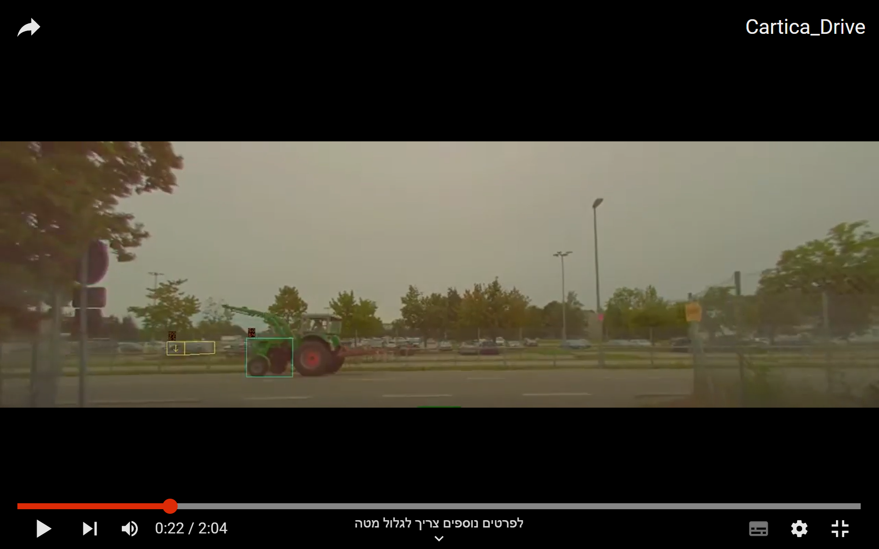
Strengths and Weaknesses
At the next 2 slide we will see few examples that I focused while analysing the system’s performance in the clip
As we can see in minute 00:21, the model could not detect properly the Tractor - the prediction rate or IoU in this case is not high enough to classified the object. The reason can be related to the mount of data collected on this type of vehicle so far and the angle the track is facing related to the camera.
The rate of FPS and the amount of bounding box labeled in this case might confirm this assumption. More data is necessary in order to achieve a good match higher variety of angels while labeling the ground truth b.boxes might help making a progress.

Slide 6
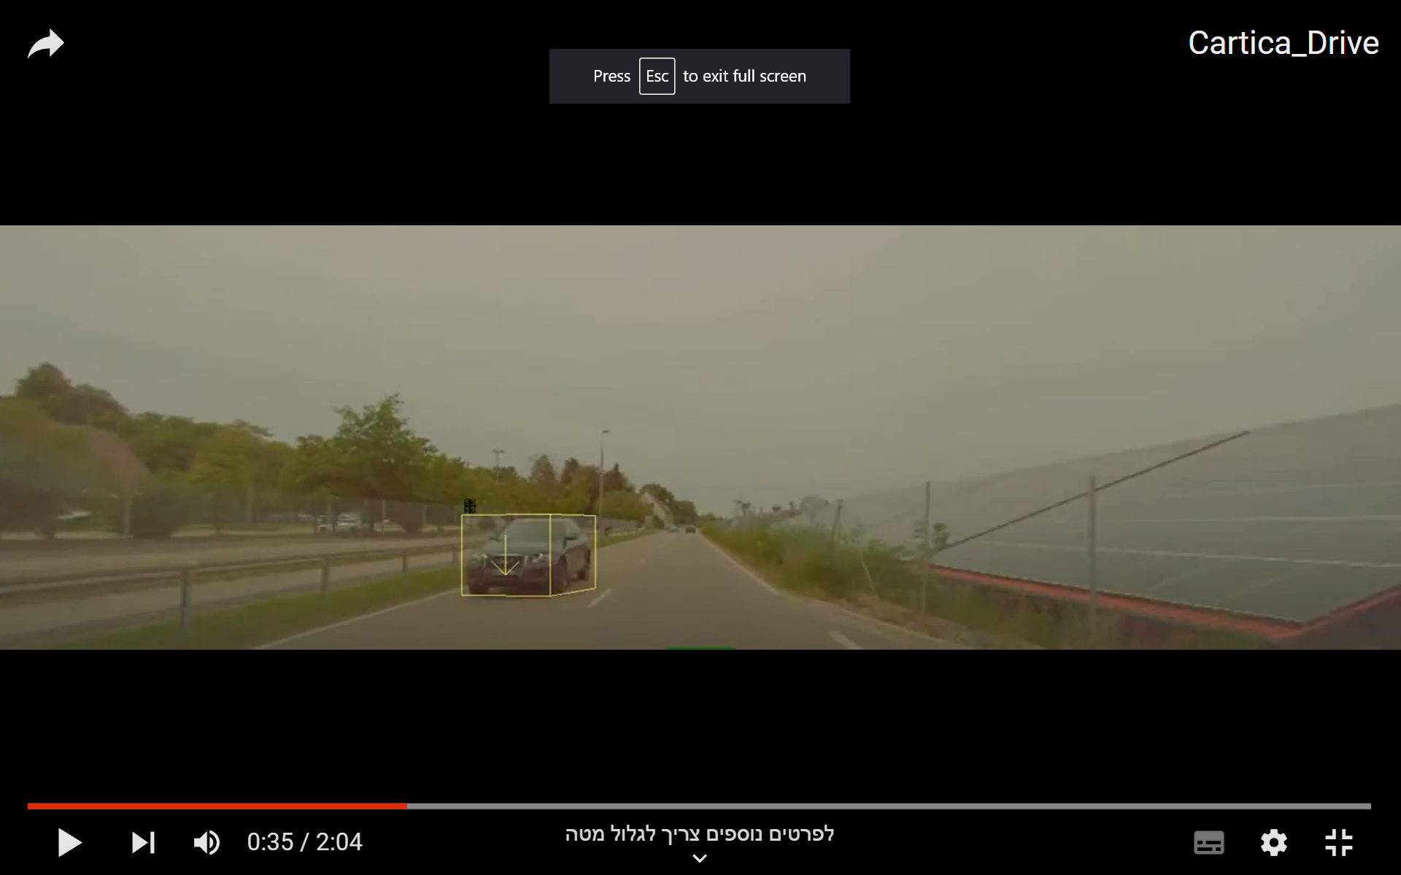
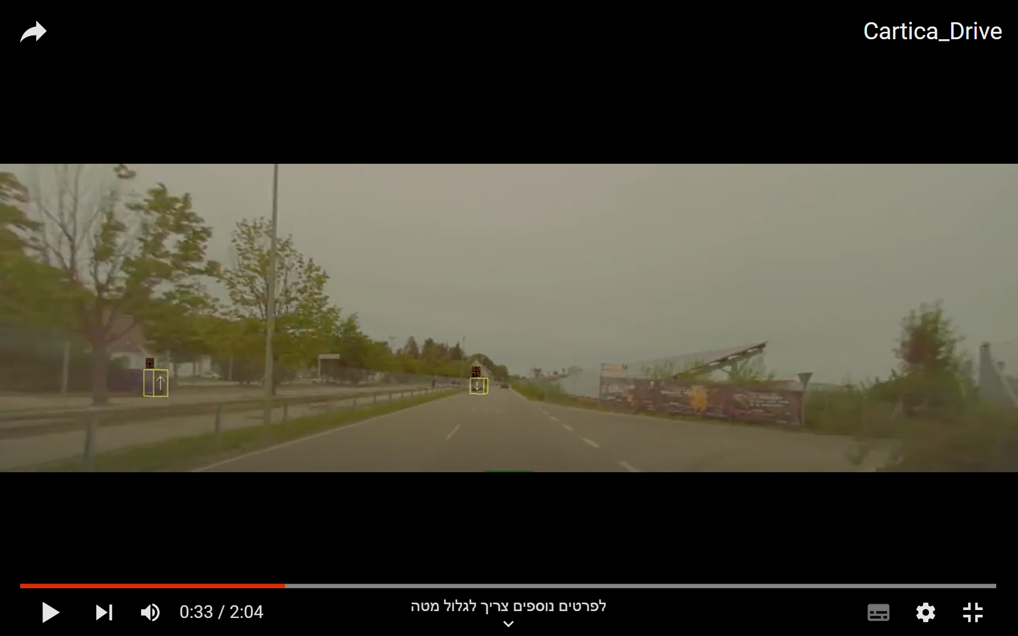
Strengths and Weaknesses 2
2. In the next example It’s seems the system classify the vehicle as True Positive quiet close to the time the cars passing by each other.

Slide 7
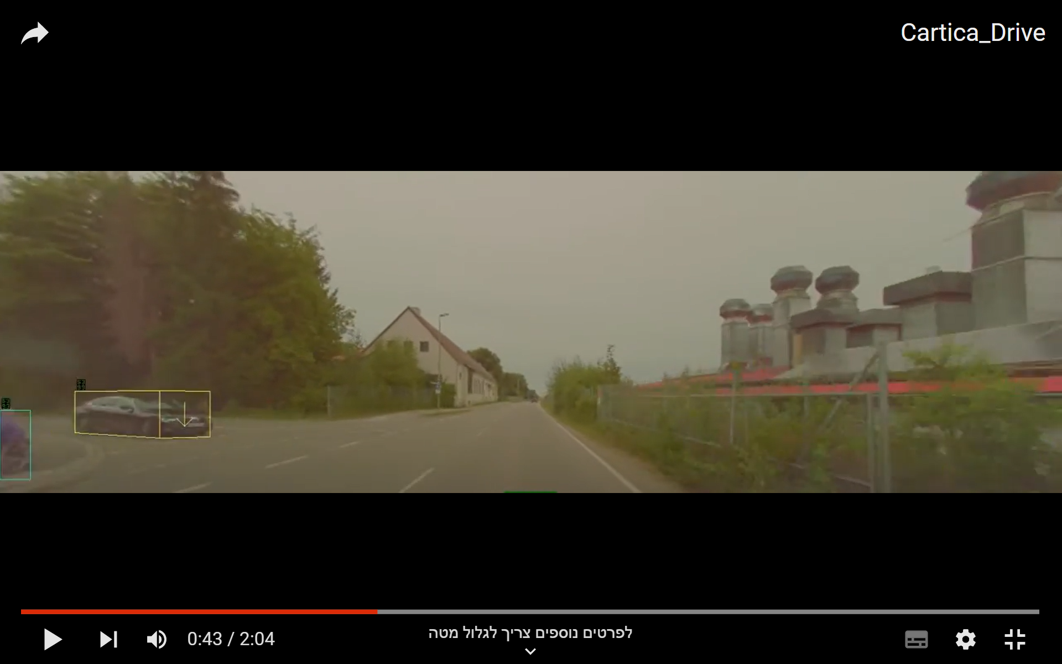
Strengths and Weaknesses 3
3. One of substantial strength of the system as demonstrated is video, is the ability to detect fast and in high accuracy vehicles showing up perpendicular to the driver’s car position. For example the vehicle shown in the following picture stepping into intersection all of a sudden. There are probably much more strengths to count, I’ll leave them for next.. Thank you, And Good luck

